Slide 1
Files
Input / Output in Files

Slide 2
Topics
File I/O
I/O Classes
FileStream
Text File
Binary File
Directory Access
Mini Project - LMS

Slide 3
File I/O
File
A file is a collection of data stored in a disk with a specific name and a directory path. When a file is opened for reading or writing, it becomes a stream.
The stream is basically the sequence of bytes passing through the communication path
Input Stream
The input stream is used for reading data from file (read operation)
Output Stream
output stream is used for writing into the file (write operation)

Slide 4
I/O Classes
I/O Class | Description
BinaryReader | Reads primitive data from a binary stream.
BinaryWriter | Writes primitive data in binary format.
BufferedStream | A temporary storage for a stream of bytes.
Directory | Helps in manipulating a directory structure.
DirectoryInfo | Used for performing operations on directories.
DriveInfo | Provides information for the drives.
File | Helps in manipulating files.
FileInfo | Used for performing operations on files.
FileStream | Used to read from and write to any location in a file.

Slide 5
I/O Classes
I/O Class | Description
MemoryStream | Used for random access to streamed data stored in memory.
Path | Performs operations on path information.
StreamReader | Used for reading characters from a byte stream.
StreamWriter | Is used for writing characters to a stream.
StringReader | Is used for reading from a string buffer.
StringWriter | Is used for writing into a string buffer.

Slide 6
FileStream
FileStream F = new FileStream ("sample.txt“ , ____ , _____ , _____ );
FileMode.Open, FileAccess.Read, FileShare.Read
FileMode | FileAccess | FileShare
Append | Read | Inheritable
Create | Write | None
CreateNew | ReadWrite | Read
Open |  | ReadWrite
OpenOrCreate |  | Write
Truncate

Slide 7
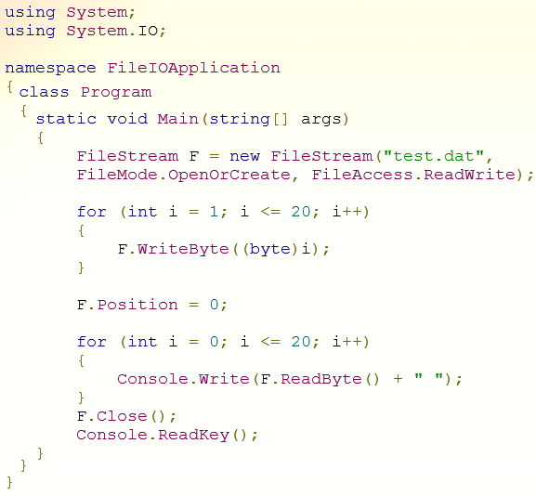
Example - FileStream
1 2 3 4 5 6 7 8 9 10 11 12 13 14 15 16 17 18 19 20 -1

Slide 8
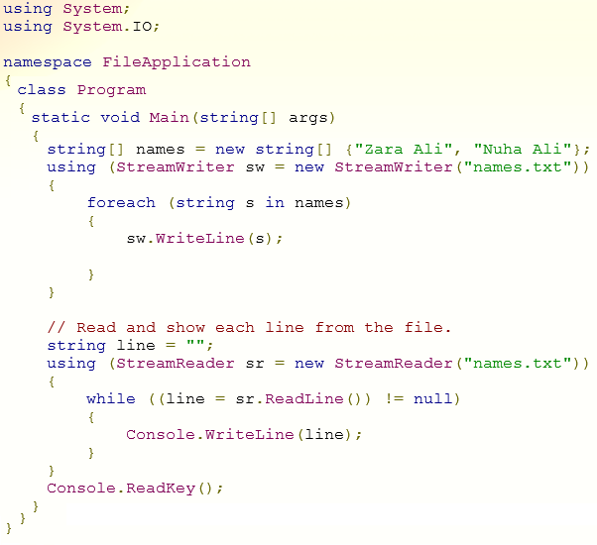
Text File Processing

Slide 9
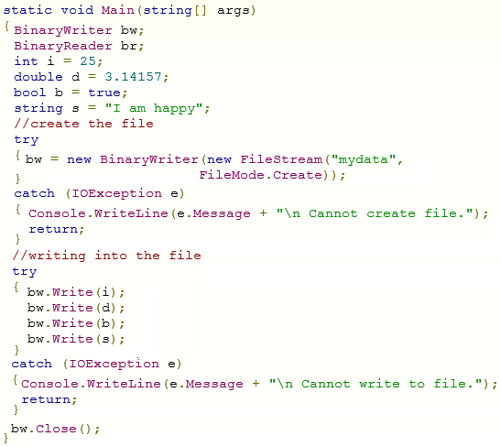
Binary File Processing - Writing

Slide 10
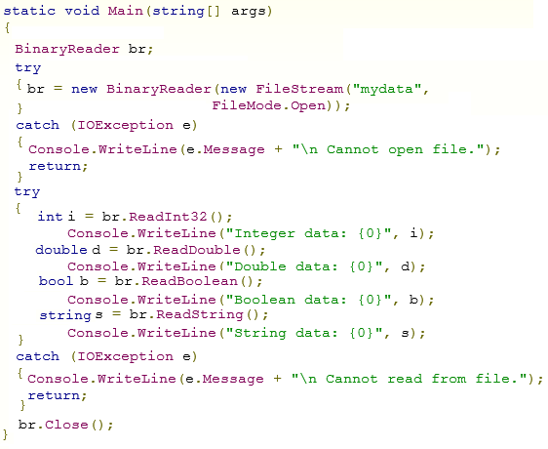
Binary File Processing - Reading

Slide 11
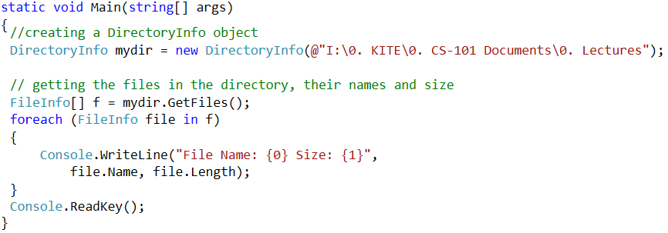
Directory Access

Slide 12
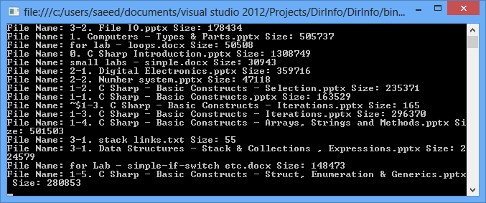
Directory Access

Slide 13
Mini Project : Library Management System
Extend Library Management System with support of File System
Write a Complete C Sharp application for LMS
Maintain Record of N Books in File < LMS.Data >
On Demand
Add New Books in Record (up to N books)
Issue Books to Teachers and Students
Update Record when any book returned.
Display records of all books and their status in tabular form.
When Application Starts it loads all previous records from File < LMS.Data >
Hints :
1. you need to learn how to read/write “struct” data types in files
2. you may also need to learn Collection ArrayList with support of struct.

